Slide 1
The DOM and JavaScript functions to modify the DOM
1

Slide 2
Topics
The DOM
JavaScript functions to modify the DOM
2

Slide 3
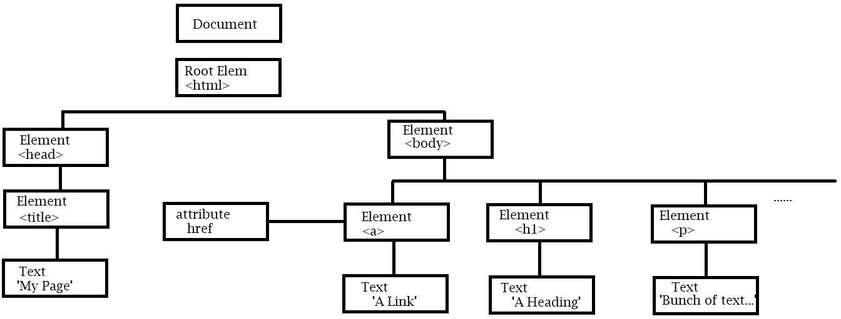
The DOM
The Document Object Model (DOM)
  Tree of objects and attributes created by web browser from structure of web page
3

Slide 4
The DOM
JavaScript can:
  Change any HTML element
  Change any HTML attribute
  Change any CSS Style
  Remove any HTML element or attribute
  Add new HTML elements and attributes
  React to all existing HTML events
  Create new HTML events
4

Slide 5
The HTML DOM
In this model:
  HTML elements are objects
  HTML elements have properties (like members) that can be altered
  The DOM provides methods that can access all HTML elements
  The DOM defines events for all HTML elements
As with OO Paradigm
  Methods are actions that can be performed
  Properties are values that can be altered
5

Slide 6
The HTML DOM
References to any element or the below get methods start with document.
  This represents the document itself.
Finding elements:
  getElementById(id) – Finds elements with an id matching the argument
(id=‘id’)
  getElementByTagName(name) – Finds elements based on their tag name
<tag> matches <name>
  getElementByClass(name) – Finds elements with a class matching the argument (class = ‘name’)
    Note: getElementXXX() calls may return more than 1 object.We will use subscripts to access a specific object.
Key Properties – ‘element’ is a variable holding an object returned by one of
the above get methods
  element.innerHTML – This is the HTML content of an element
  element.attribute – (where ‘attribute’ is an attribute name)
  element.style.property – (where ‘property’ is the name of a style setting)
6

Slide 7
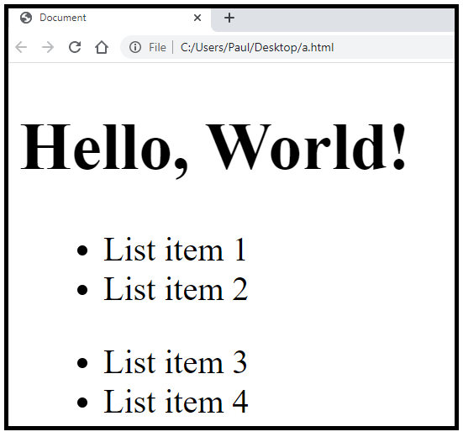
The HTML DOM Example
<!DOCTYPE html>
<html lang="en">
<head>
<meta charset="UTF-8">
<meta name="viewport" content="width=device-width, initial-scale=1.0">
<meta http-equiv="X-UA-Compatible" content="ie=edge">
<title>Document</title>
</head>
<body>
<h1>Hello, World!</h1>
<ul>
<li>List item 1</li>
<li>List item 2</li>
</ul>
<ul>
<li>List item 3</li>
<li>List item 4</li>
</ul>
<p id="demo"></p>
</body>
</html>
7

Slide 8
The HTML DOM Example
// in the Console
var x = document.getElementsByTagName("li");
// gets all the li elements console.log(x);
document.getElementById("demo").innerHTML = '1st list item: ' + x[0].innerHTML
+ '<br>2nd list item: ' + x[1].innerHTML
+ '<br>3rd list item: ' + x[2].innerHTML
+ '<br>4th list item: ' + x[3].innerHTML;
document.getElementById("demo").style.color = "red";
8

Slide 9
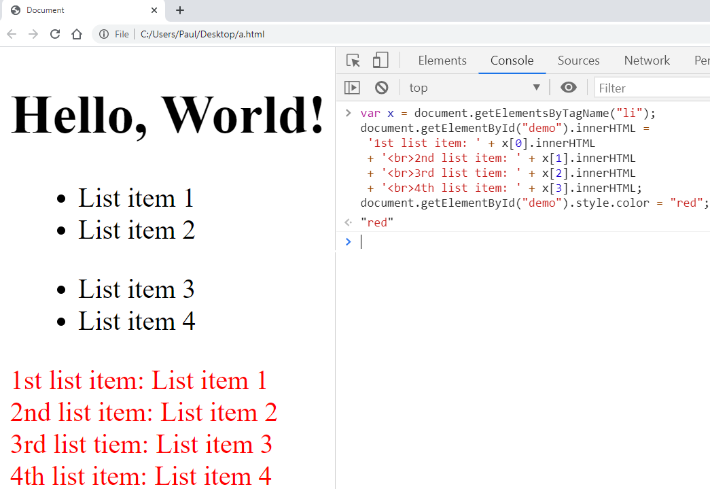
The HTML DOM Example
9

Slide 10
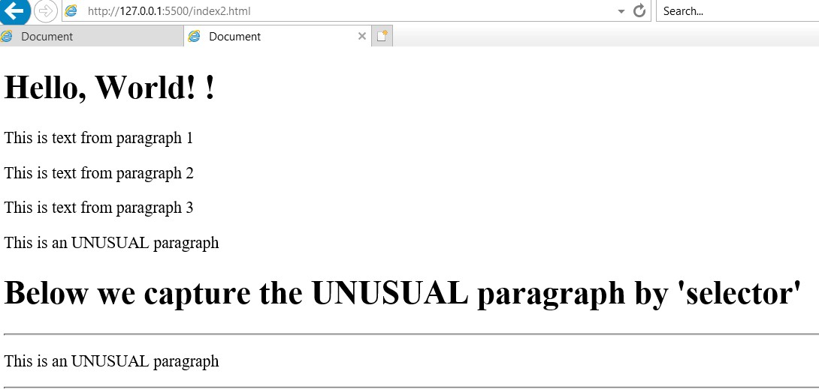
The HTML DOM Example
<!DOCTYPE html>
<html lang="en">
<head>
<meta charset="UTF-8">
<meta name="viewport" content="width=device-width, initial-scale=1.0">
<meta http-equiv="X-UA-Compatible" content="ie=edge">
<title>Document</title>
</head>
<body>
<h1>Hello, World! !</h1>
<p id="one">This is text from paragraph 1</p>
<p id="two">This is text from paragraph 2</p>
<p id="three">This is text from paragraph 3</p>
<p class="unusual">This is an UNUSUAL paragraph</p>
<h1>Below we capture the UNUSUAL paragraph by A'selector'</h1>
<hr>
<p id="demo"></p>
<hr>
</body>
</html>
// in the console:
var x = document.querySelectorAll("p.unusual"); document.getElementById("demo").innerHTML =
x[0].innerHTML;
10

Slide 11
The HTML DOM Example
<!DOCTYPE html>
<html lang="en">
<head>
<meta charset="UTF-8">
<meta name="viewport" content="width=device-width, initial-scale=1.0">
<meta http-equiv="X-UA-Compatible" content="ie=edge">
<title>Document</title>
</head>
<body>
<h1>Hello, World! !</h1>
<p id="one">This is text from paragraph 1</p>
<p id="two">This is text from paragraph 2</p>
<p id="three">This is text from paragraph 3</p>
<p class="unusual">This is an UNUSUAL paragraph</p>
<h1>Below we capture the UNUSUAL paragraph by A'selector'</h1>
<hr>
<p id="demo"></p>
<hr>
<script src="demo.js"></script>
</body>
</html>
// demo.js:
var x = document.querySelectorAll("p.unusual"); document.getElementById("demo").innerHTML =
x[0].innerHTML;

Slide 12
The HTML DOM Example
<!DOCTYPE html>
<html lang="en">
<head>
<meta charset="UTF-8">
<meta name="viewport" content="width=device-width, initial-scale=1.0">
<meta http-equiv="X-UA-Compatible" content="ie=edge">
<title>Document</title>
</head>
<body>
<h1>Hello, World! !</h1>
<p id="one">This is text from paragraph 1</p>
<p id="two">This is text from paragraph 2</p>
<p id="three">This is text from paragraph 3</p>
<p class="unusual">This is an UNUSUAL paragraph</p>
<h1>Below we capture the UNUSUAL paragraph by A'selector'</h1>
<hr>
<p id="demo"></p>
<hr>
<script>
var x = document.querySelectorAll("p.unusual"); document.getElementById("demo").innerHTML =
x[0].innerHTML;
</script>
</body>
</html>

Slide 13
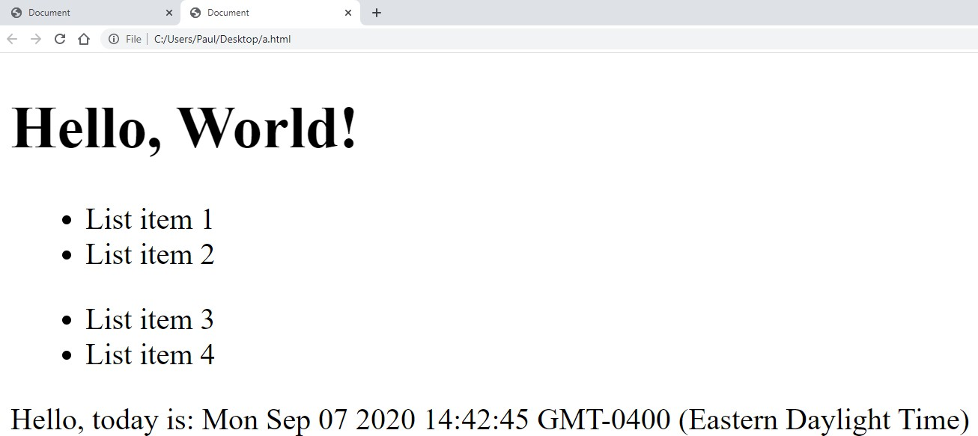
The HTML DOM - Writing into the HTML Stream
<!DOCTYPE html>
JavaScript document.write() will add text directly into an HTML page
<html lang="en">
<head>
<meta charset="UTF-8">
<meta name="viewport" content="width=device-width, initial- scale=1.0">
<meta http-equiv="X-UA-Compatible" content="ie=edge">
<title>Document</title>
</head>
<body>
<h1>Hello, World!</h1>
<ul>
<li>List item 1</li>
<li>List item 2</li>
</ul>
<ul>
<li>List item 3</li>
<li>List item 4</li>
</ul>
<p id="demo"></p>
<script>document.write("Hello, today is: " + Date());</script>
</body>
</html>

Slide 14
The HTML DOM - Changing Attributes
You can change an attribute by getting the element and assigning a value to the attribute
<IMG id="image1" src="Paul1.jpg">
  Can change the src attribute with: document.getElementById("image1").src = "Paul2.jpg";

Slide 15
The HTML DOM – Changing Styles
You can change style by assigning to any of the style properties on an element
The format to access a style property is:
<object>.style.<propertyname>
  <object> is the object returned by getElementByXXX() calls
  style is just a keyword to indicate the upcoming field is a style attribute
  <propertyname> is the name of the CSS property

Slide 16
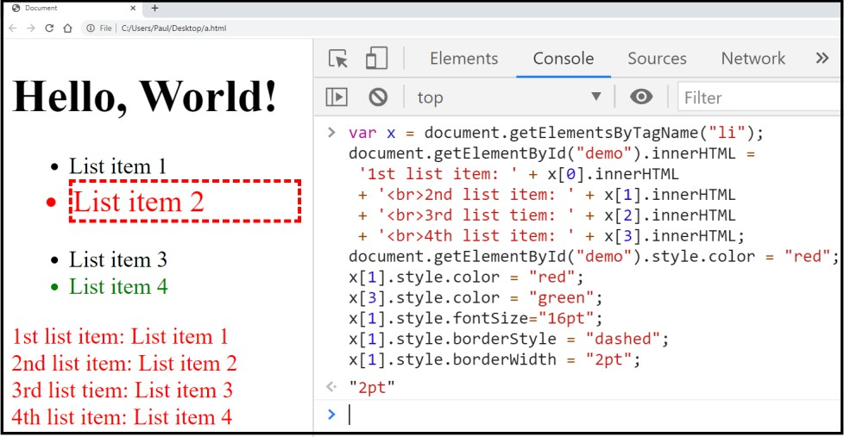
The HTML DOM – Changing Styles - Example
<!DOCTYPE html>
<html lang="en">
<head>
<meta charset="UTF-8">
<meta name="viewport" content="width=device- width, initial-scale=1.0">
<meta http-equiv="X-UA-Compatible" content="ie=edge">
<title>Document</title>
</head>
<body>
<h1>Hello, World!</h1>
<ul>
<li>List item 1</li>
<li>List item 2</li>
</ul>
<ul>
<li>List item 3</li>
<li>List item 4</li>
</ul>
<p id="demo"></p>
<script>document.write("Hello, today is: " + Date());</script>
</body>
</html>
var x = document.getElementsByTagName("li"); document.getElementById("demo").innerHTML = '1st list item: ' + x[0].innerHTML
+ '<br>2nd list item: ' + x[1].innerHTML
+ '<br>3rd list tiem: ' + x[2].innerHTML
+ '<br>4th list item: ' + x[3].innerHTML; document.getElementById("demo").style.color = "red"; x[1].style.color = "red";
x[3].style.color = "green"; x[1].style.fontSize="16pt"; x[1].style.borderStyle = "dashed"; x[1].style.borderWidth = "2pt";

Slide 17
The HTML DOM - Events
Can execute code when an event occurs.
  Events include:
    When a user clicks the mouse (onclick=)
    When a web page has loaded (onload= , onunload=)
    When an image has been loaded (onload=)
    When the mouse moves over an element (onmouseover= , onmouseout=)
    When an input field is changed (onchange=)
    When an HTML form is submitted (onsubmit=)
    When a user strokes a key (onkeypress=)

Slide 18


The HTML DOM – Events - Example
<!DOCTYPE html>
<html>
<body>
<h1 id="id1">My Heading 1</h1>
<!-- we can put JavaScript code in the onclick action -->
<button type="button" onclick="document.getElementById('id1').style.color = 'red'">Click Me!</button>
</body>
</html>
Before clicking the ‘Click Me!’ button
After clicking the ‘Click Me!’ button

Slide 19
The HTML DOM – Building HTML
JavaScript can modify the DOM of a document and add or remove elements
Use ‘createXXX() methods:
  createElement() – Creates and returns a new element node
  createTextNode() – Creates a node that holds text
Use various methods to add or remove nodes:
  addChild() – Adds a child to a node
  insertBefore() – Inserts a new node before a specific child
  removeChild() – Removes a node from the DOM
  replaceChild() – Replaces one child node with another

Slide 20
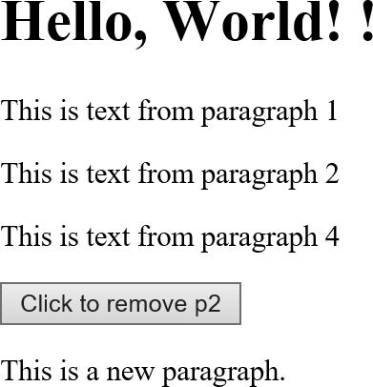
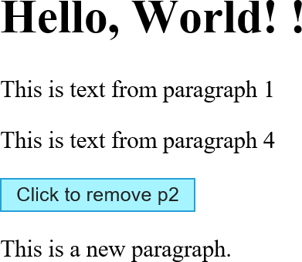
The HTML DOM – Building HTML Example
<!DOCTYPE html>
<html lang="en">
Before click
<head>
<meta charset="UTF-8">
<title>Document</title>
</head>
<body>
<div id="theDiv">
<h1>Hello, World! !</h1>
<p id="one">This is text from paragraph 1</p>
<p id="two">This is text from paragraph 2</p>
<p id="four">This is text from paragraph 4</p>
<button onclick="remv(document.getElementById('two'))">Click to remove p2</button>
</div>
<script src="demo.js"></script>
</body>
</html>
demo.js:
var newPara = document.createElement("p");
var content = document.createTextNode("This is a new paragraph.");
newPara.appendChild(content);
var divElem = document.getElementById("theDiv"); divElem.appendChild(newPara);
function remv(element) { element.parentNode.removeChild(element);
}
After click

Slide 21
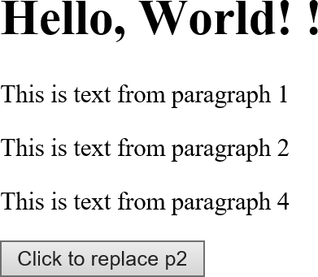
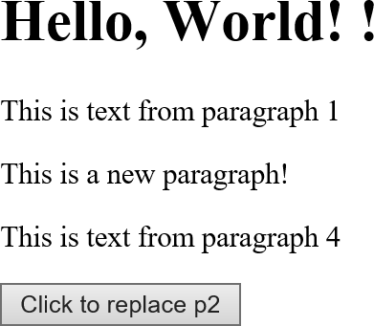
The HTML DOM – Building HTML Example
<!DOCTYPE html>
Before Click
<html lang="en">
<head>
<meta charset="UTF-8">
<title>Document</title>
</head>
<body>
<div id="theDiv">
<h1>Hello, World! !</h1>
<p id="one">This is text from paragraph 1</p>
<p id="two">This is text from paragraph 2</p>
<p id="four">This is text from paragraph 4</p>
<button onclick="repl(document.getElementById('two'))">Click to replace p2</button>
</div>
<script>
function repl(element) {
var para = document.createElement("p");
var node = document.createTextNode("This is a new paragraph!"); para.appendChild(node);
element.parentNode.replaceChild(para, element);
}
</script>
</body>
</html>
After Click

Slide 22
Events in JavaScript
In JavaScript, events are actions or occurrences that happen in the browser and can be detected and responded to by JavaScript.
They represent interactions between the user and the web page.
Examples:
1. A user clicks a button
2. A web page loads
3. A key is pressed on the keyboard
4. A form submits
JavaScript allows us to write code that responds to these events — this process is called event handling.

Slide 23
What is an Event?
An event is a signal that something has happened.
When an event occurs, the browser generates an event object, which contains information about that event.
Example:
<button onclick="alert('Button clicked!')">Click Me</button>
When the button is clicked:
The browser detects the click event
Executes the JavaScript code inside the attribute (alert() in this case)

Slide 24
Event Flow
There are two main models that describe how events propagate (move) through the DOM (Document Object Model):
(a) Event Capturing (Trickling Down)
The event starts from the root (document) and moves down to the target element.
Capturing phase is from top to bottom.
(b) Event Bubbling (Going Up)
The event starts from the target element and bubbles up to the root element.
Bubbling phase is from bottom to top.
Example Diagram:
          document → body → div → button
          ↑ ↓
          Capturing Phase Bubbling Phase

Slide 25
Event Handling
Event handling means writing JavaScript code to respond to an event.
There are 3 ways to handle events in JavaScript:
  Inline Event Handling (HTML Attribute Method)
  Traditional DOM Event Handling (Property Method)
  Modern Event Handling (addEventListener() Method)

Slide 26
Inline Event Handling
Event handler written directly inside HTML attribute.
<button onclick="alert('Hello!')">Click Me</button>

Slide 27
Traditional DOM Event Handling
Assign function directly to an element’s event property.
document.getElementById("btn").onclick = function() {
alert("Clicked!");
};
Limitation:
Only one event handler can be attached to a single event — later assignments overwrite the previous ones

Slide 28
Modern Event Handling
Using addEventListener() to attach multiple handlers.
element.addEventListener("click", function() {
alert("Button clicked!");
});
<button id="btn">Click Me</button>
<script>
document.getElementById("btn").addEventListener("click", function() {
alert("Button clicked using addEventListener!");
});
</script>
Advantages:
1. Can add multiple event listeners for the same event.
2. Works well with event capturing and bubbling.
3. Cleaner and more modern approach.

Slide 29
Common Events
Category | Event Name | Description
Mouse Events | click, dblclick, mouseover, mouseout, mousedown, mouseup, mousemove | Triggered by mouse actions
Keyboard Events | keydown, keypress, keyup | Triggered when keys are pressed
Form Events | submit, focus, blur, change, input, reset | Triggered during form interactions
Window Events | load, resize, scroll, unload, beforeunload | Triggered on the browser window or document
Clipboard Events | copy, cut, paste | Triggered when using clipboard actions

Slide 30
Removing Event Listeners
Use removeEventListener() to detach handlers.
function greet() {
alert("Hello!");
}
btn.addEventListener("click", greet);
btn.removeEventListener("click", greet);

Slide 31
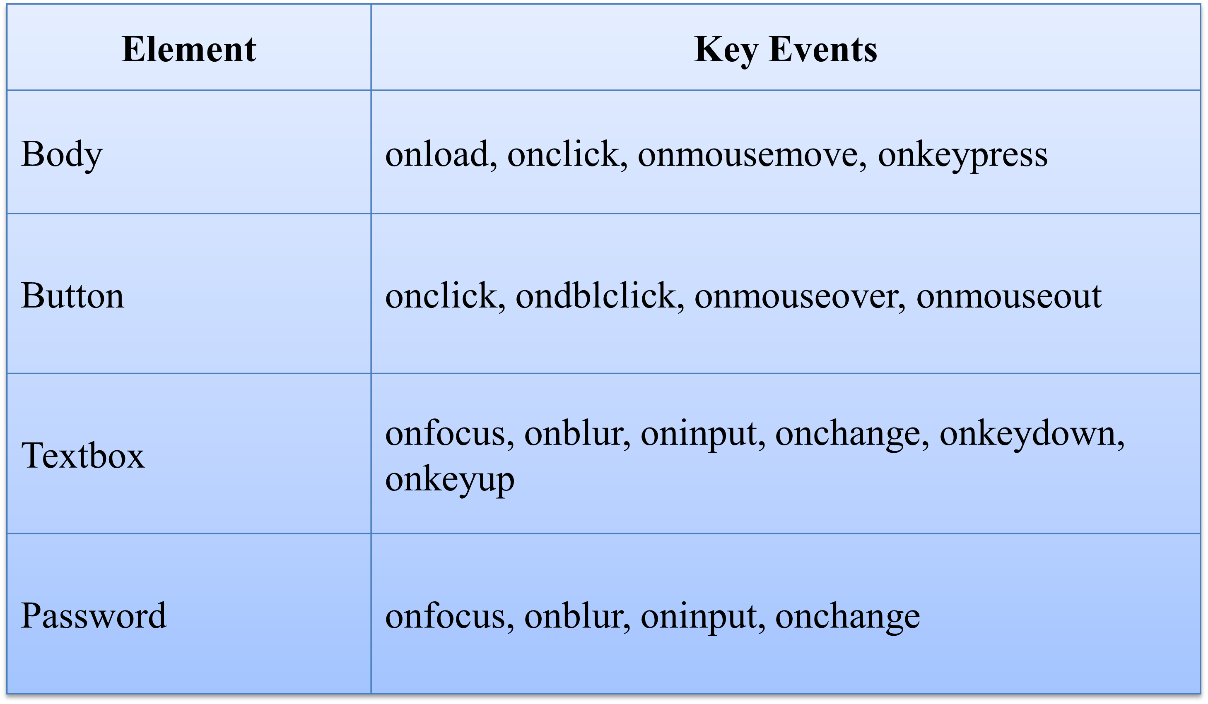
Handling events from the Body, Button, Textbox, password elements.

